Slide 1
Model Learning, Validation, and Overfitting June 11, 2020
Lecture 3, Applied Data Science
MMCi Term 4, 2020
Matthew Engelhard
Notes:
Name
Department & DS Program
I work in…
I’m here to…
This will be the first of three lectures this spring focused on ways data science is positioned to change (and beginning to change) clinical practice. We’re doing this because we think these technologies are going to have a major impact on the way you practice medicine, and we want you to be ready for them.

Slide 2
Model Learning

Slide 3
Learning (or training) our model means:
-> Setting our parameters to the specific values that are the best match for our training data
What do we mean by “best match”?
-> We set our parameters to the values that maximize some measure of fit
-> Alternatively, we set them to values that minimize a penalty (i.e. a loss) that we choose

Slide 4
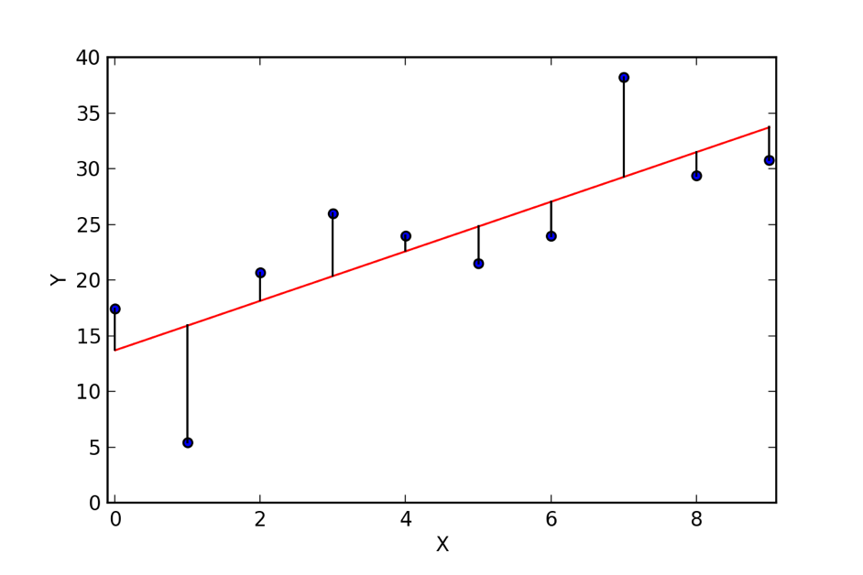
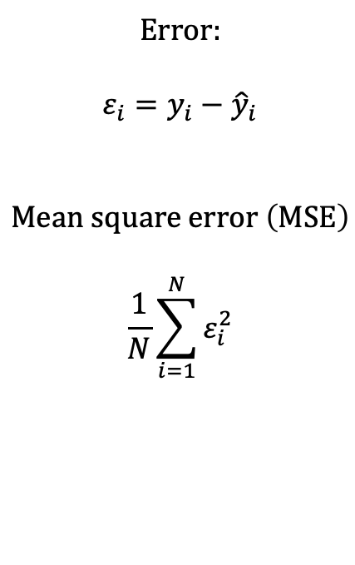
Linear Regression Measure of Fit: Mean Squared Error
𝜀₈
Error:
$$ε_{i}=y_{i}−{\hat{y}}_{i}$$
$$Mean square error \left(MSE\right)$$
$$\frac{1}{N}\sum_{i=1}^{N}{ε_{i}^{2}}$$
𝜀₁₀
𝜀₉
𝜀₇
𝜀₄
𝜀₅
𝜀₆
𝜀₃
𝜀₁
𝜀₂
Notes:
Root mean square error, normalized mean square error, etc, but these are the essentials
Other ways to measure distance between the prediction and the truth that might be appropriate for specific applications
Note that Normalized MSE is 1-R^2

Slide 5
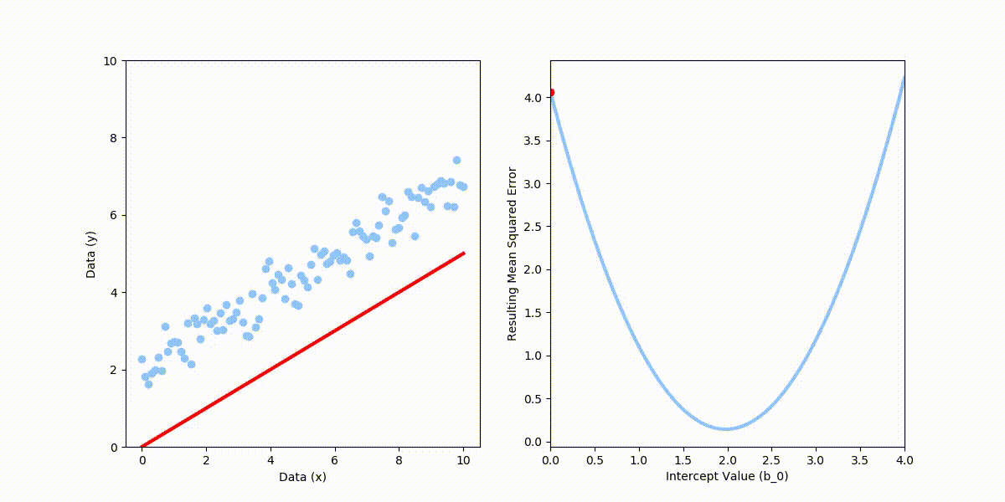
Suppose the slope is known. What happens to the MSE as we move the intercept (b₀)?
Notes:
Root mean square error, normalized mean square error, etc, but these are the essentials
Other ways to measure distance between the prediction and the truth that might be appropriate for specific applications
Note that Normalized MSE is 1-R^2

Slide 6
What is the best choice of intercept (b₀) for these data, the one that minimizes the mean squared error?
Notes:
Root mean square error, normalized mean square error, etc, but these are the essentials
Other ways to measure distance between the prediction and the truth that might be appropriate for specific applications
Note that Normalized MSE is 1-R^2

Slide 7
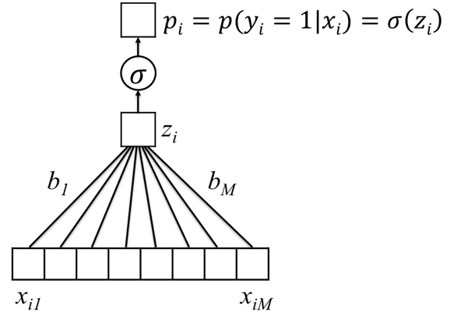
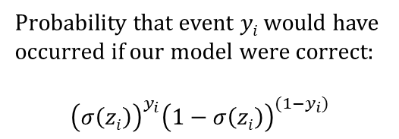
Logistic Regression Measure of Fit:
Probability that events $y1,…,yN$would have occurred if our model were correct
Probability that event $yi$ would have occurred if our model were correct:
$${\left(σ\left(zi\right)\right)}^{y_{i}}{\left(1−σ\left(zi\right)\right)}^{(1−y_{i})}$$
Notes:
This is called the likelihood.

Slide 8
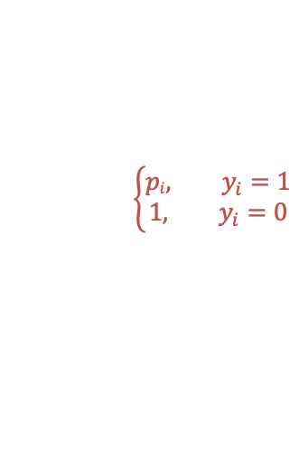
Logistic Regression Measure of Fit:
Probability that events $y1,…,yN$would have occurred if our model were correct
Probability that event $yi$ would have occurred if our model were correct:
$${\left(σ\left(zi\right)\right)}^{y_{i}}{\left(1−σ\left(zi\right)\right)}^{(1−y_{i})}$$
$$\left\{\begin{aligned}pi, y_{i}=1 \\ 1, y_{i}=0\end{aligned}\right.$$
Notes:
This is called the likelihood.

Slide 9
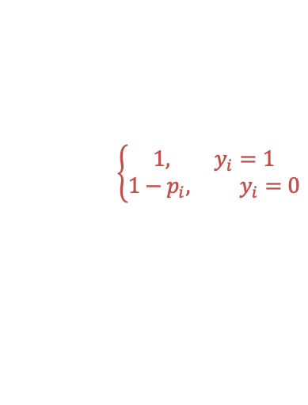
Logistic Regression Measure of Fit:
Probability that events $y1,…,yN$would have occurred if our model were correct
Probability that event $yi$ would have occurred if our model were correct:
$${\left(σ\left(zi\right)\right)}^{y_{i}}{\left(1−σ\left(zi\right)\right)}^{(1−y_{i})}$$
$$\left\{\begin{aligned}1, y_{i}=1 \\ 1−p_{i}, y_{i}=0\end{aligned}\right.$$
Notes:
This is called the likelihood.

Slide 10
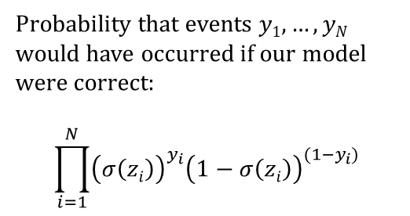
Logistic Regression Measure of Fit:
Probability that events $y1,…,yN$would have occurred if our model were correct
Probability that event $yi$ would have occurred if our model were correct:
$${\left(σ\left(zi\right)\right)}^{y_{i}}{\left(1−σ\left(zi\right)\right)}^{(1−y_{i})}$$
Probability that events $y1,…,yN$ would have occurred if our model were correct:
$$\prod_{i=1}^{N}{{\left(σ\left(zi\right)\right)}^{y_{i}}{\left(1−σ\left(zi\right)\right)}^{(1−y_{i})}}$$
Notes:
This is called the likelihood.

Slide 11
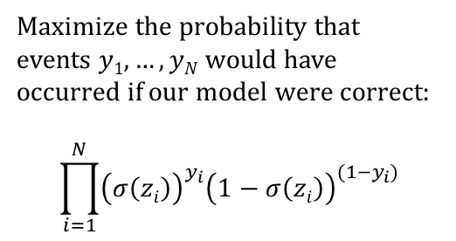
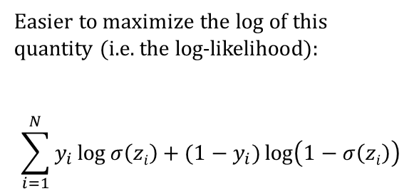
Logistic Regression Measure of Fit:
Probability that events $y1,…,yN$would have occurred if our model were correct
Maximize the probability that events $y1,…,yN$ would have occurred if our model were correct:
$$\prod_{i=1}^{N}{{\left(σ\left(zi\right)\right)}^{y_{i}}{\left(1−σ\left(zi\right)\right)}^{(1−y_{i})}}$$
Easier to maximize the log of this quantity (i.e. the log-likelihood):
$$\sum_{i=1}^{N}{y_{i}\log{σ\left(zi\right)}+(1−y_{i})\log\left(1−σ\left(zi\right)\right)}$$
Notes:
This is called the likelihood.

Slide 12
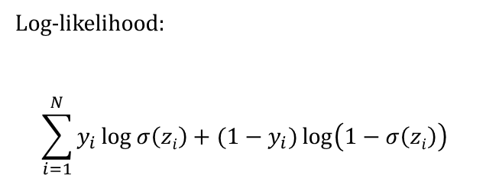
Maximize the log-likelihood = minimize the “cross-entropy” loss
Log-likelihood:
$$\sum_{i=1}^{N}{y_{i}\log{σ\left(zi\right)}+(1−y_{i})\log\left(1−σ\left(zi\right)\right)}$$
Notes:
This is called the likelihood.

Slide 13
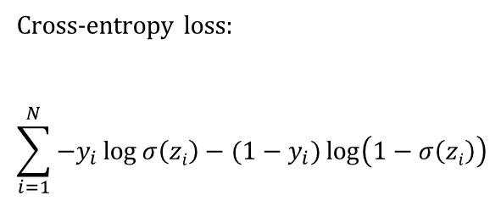
Maximize the log-likelihood = minimize the “cross-entropy” loss
Cross-entropy loss:
$$\sum_{i=1}^{N}{−y_{i}\log{σ\left(zi\right)}−(1−y_{i})\log\left(1−σ\left(zi\right)\right)}$$
The cross-entropy loss is also used for other classification models, including convolutional neural network classifiers for image processing.
Cross-entropy loss for z
Notes:
This is called the likelihood.

Slide 14
How do we minimize the loss?
The cross-entropy loss just tells us what quantity we should be minimizing
In some cases (e.g. linear regression), we can solve for the minimum directly
But, we’d like to have an approach that works even for very complex models

Slide 15
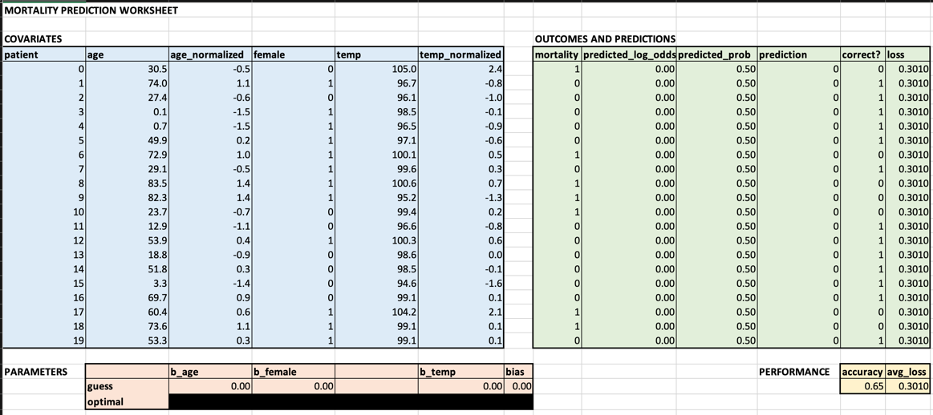
Strategy: determine how small changes in parameters affect the loss

Slide 16
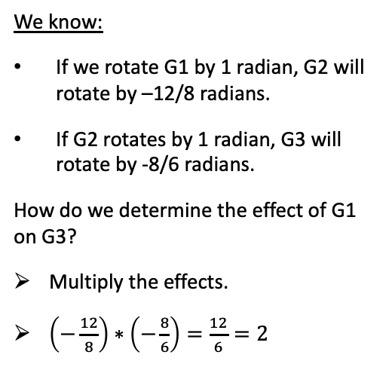
Strategy: determine how small changes in parameters affect the loss
We know:
If we rotate G1 by 1 radian, G2 will rotate by –12/8 radians.
If G2 rotates by 1 radian, G3 will rotate by -8/6 radians.
How do we determine the effect of G1 on G3?
Multiply the effects.
$\left(−\frac{12}{8}\right)∗\left(−\frac{8}{6}\right)=\frac{12}{6}=2$
G1
G2
G3

Slide 17
Strategy: determine how small changes in parameters affect the loss
We know:
If we rotate G1 by 1 radian, G2 will rotate by –12/8 radians.
If G2 rotates by 1 radian, G3 will rotate by -8/6 radians.
How do we determine the effect of G1 on G3?
Multiply the effects.
$\left(−\frac{12}{8}\right)∗\left(−\frac{8}{6}\right)=\frac{12}{6}=2$
G1
G2
G3

Slide 18
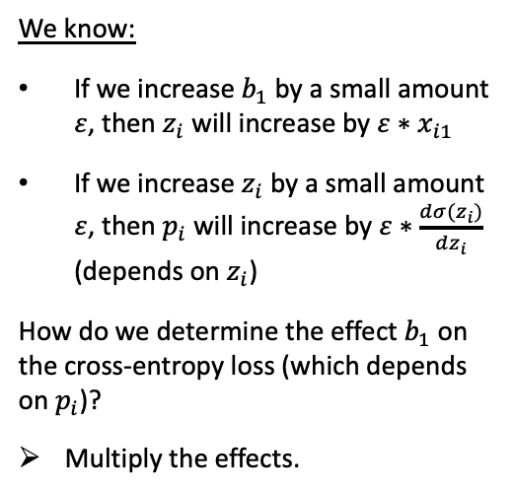
Strategy: determine how small changes in parameters affect the loss
We know:
If we increase $b_{1}$ by a small amount $ε$, then $z_{i}$ will increase by $ε∗x_{i1}$
If we increase $z_{i}$ by a small amount $ε$, then $p_{i}$ will increase by $ε∗\frac{dσ(z_{i})}{dz_{i}}$ (depends on $z_{i}$)
How do we determine the effect $b_{1}$ on the cross-entropy loss (which depends on $p_{i}$)?
Multiply the effects.

Slide 19
Strategy: determine how small changes in parameters affect the loss
This is called the chain rule (calc 101)
We use it to see how small changes in parameters affect the loss
Could be a very long chain…
Some parameters have a greater effect than others
We change all parameters at once, with each change proportional to that parameter’s effect on the loss
This is gradient descent

Slide 20
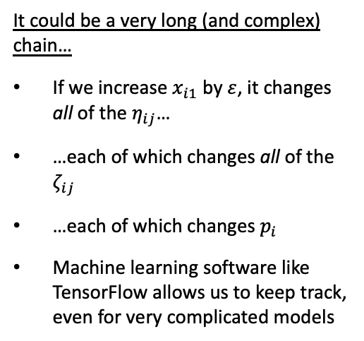
Strategy: determine how small changes in parameters affect the loss
It could be a very long (and complex) chain…
If we increase $x_{i1}$ by $ε$, it changes all of the $η_{ij}$…
…each of which changes all of the $ζ_{ij}$
…each of which changes $p_{i}$
Machine learning software like TensorFlow allows us to keep track, even for very complicated models

Slide 21
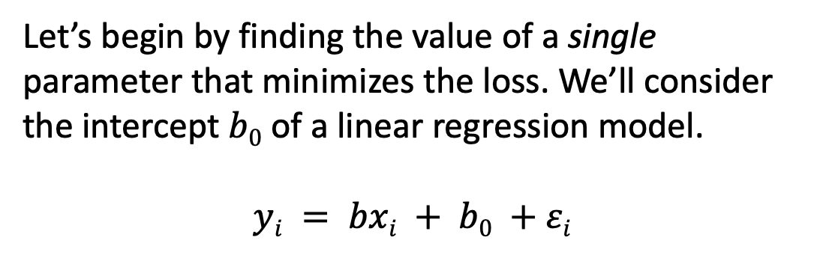
Learning: find parameters that minimize the loss
Let’s begin by finding the value of a single parameter that minimizes the loss. We’ll consider the intercept $b0$ of a linear regression model.
$$yi = bxi + b0 +εi$$

Slide 22
Learning: find parameters that minimize the loss
Easy!!
Notes:
Important to note here – just because moving in one direction lowers the loss, doesn’t mean we can move in that direction indefinitely

Slide 23
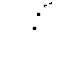
Learning: find parameters that minimize the loss
?
Easy!!

Slide 24
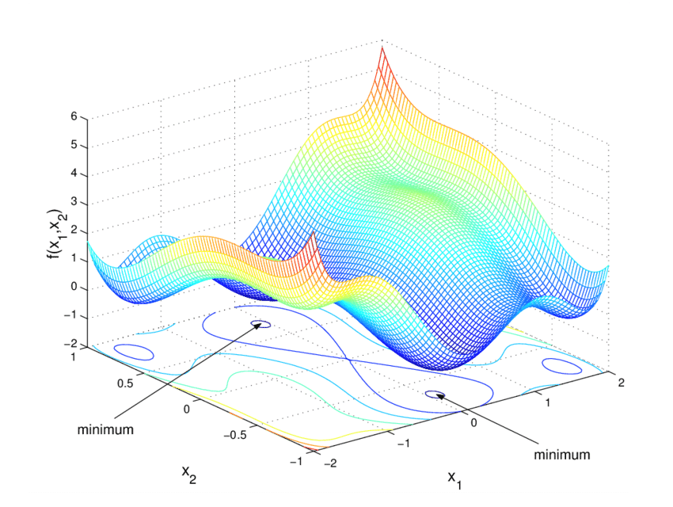
Learning: find parameters that minimize the loss
?
Easy?

Slide 25


Learning: find parameters that minimize the loss
Not easy.

Slide 26
Learning: find parameters that minimize the loss
Not easy.

Slide 27


Learning: find parameters that minimize the loss
With deep learning models, we are trying to minimize a function of many variables
Can’t visualize it
Can’t solve for the minimum directly
So, we follow the slope and hope for the best (i.e. gradient descent)
May end up in a low point that isn’t the lowest, i.e. local minimum
But, if we have lots of data, things usually work out OK

Slide 28
Overfitting

Slide 29
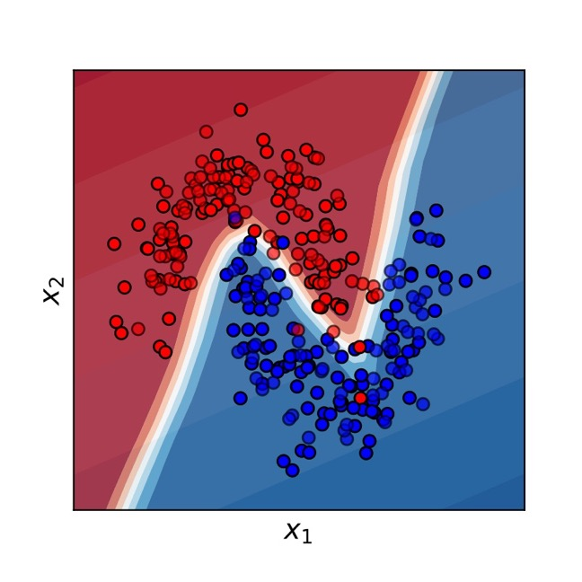
We like flexible, non-linear decision boundaries…

Slide 30
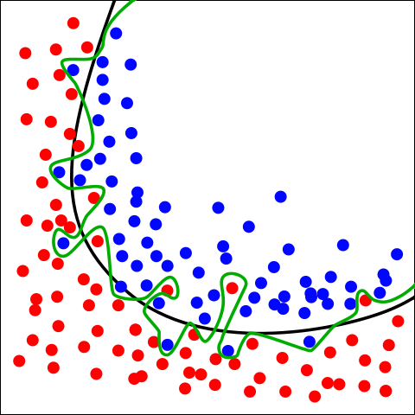
But some models can be too flexible.
Green boundary:
This is overfitting
Black boundary:
Balance between fit and model complexity
-> The black boundary is likely to perform better on new data
By Chabacano - Own work, CC BY-SA 4.0, https://commons.wikimedia.org/w/index.php?curid=3610704
Notes:
Willingness to embrace complex models → need this better approach to overfitting.

Slide 31
Overfitting
“Overfitting” happens when the learned model increases complexity to fit the observed training data too well – will not work to predict future data!
What would we want to use to fit these example data points?

Slide 32
Classic Example: Increasing Polynomial Order
Increasing complexity does not seem appropriate…
Notes:
Fair question: why is left better than right? If we knew that our observations were perfect, and that x was the only thing that affected y, then we’d need a function that goes through all points perfectly
But, there’s randomness. Or, at least there are things affecting y other than x.

Slide 33
With a flexible enough model, we can typically reach 100% accuracy on our training set
Increasing complexity does not seem appropriate…
Notes:
Notice that the 8-order fit will take some big parameter values – we penalize them, we prevent this

Slide 34
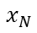
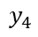
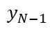
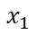
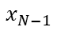
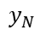
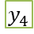
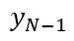
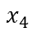
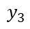
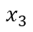
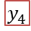
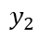
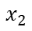
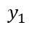
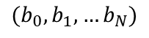
Using a Test Set Protects Against Overfitting:
See how the model performs on new data
Refine Model
$$x_{1}$$
$$y_{1}$$
$$x_{1}$$
$$y_{1}$$
$$x_{2}$$
$$y_{2}$$
$$x_{2}$$
$$y_{2}$$
$$x_{3}$$
$$y_{3}$$
$$x_{3}$$
$$y_{3}$$
$$x_{4}$$
$$y_{4}$$
$$x_{4}$$
$$y_{4}$$
$$x_{1}$$
$$y_{1}$$
$$x_{N−1}$$
$$x_{2}$$
$$y_{2}$$
$$x_{N−1}$$
$$y_{N−1}$$
$$x_{N}$$
$$y_{N}$$
$$x_{3}$$
$$y_{3}$$
$$x_{N}$$
$$y_{N}$$
Training Set
$$x_{4}$$
$$y_{4}$$
Test
$$x_{N−1}$$
$$y_{N−1}$$
$$x_{N}$$
$$y_{N}$$
$({b_{0},b}_{1},…b_{N})$
Validation
Estimate Performance on Validation Set
Final Performance Evaluation
Notes:
But, for all we know, the right-most model could be good. To find out? Try out some new data you haven’t seen before.

Slide 35
Early Stopping
During optimization, we can check the validation loss as we go.
Instead of optimizing to convergence, we can optimize until the validation loss stops improving
Saves computational cost
Performs better on validation (and test) sets
Widely used technique in the field
Best Validation (and Generalization) Here
Training Loss Keeps Improving

Slide 36
Other Ways to Use the Validation Set
Choosing between models (e.g. MLP, LR)
Choosing how strongly to regularize the model, i.e. penalize parameters
Choosing network depth, width, etc.
Many other “hyperparameters” we might tune

Slide 37
Conclusions
Learning consists in setting model parameters to maximize some measure of fit (or equivalently, minimize some loss)
This sounds easy, but is difficult in practice when working with complex models
Greater model complexity is often, but not always, advantageous
Proper model validation is critical to estimate real-world performance and prevent overfitting

